Slide 1
Anscombe’s Quartet
John F. Tripp

Slide 2
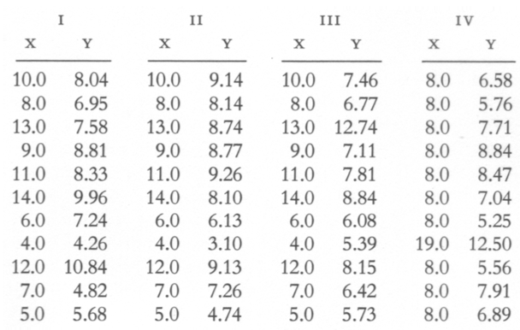
Anscombe’s Quartet
Notes:
ANSCOMBE’S Quartet

Slide 3
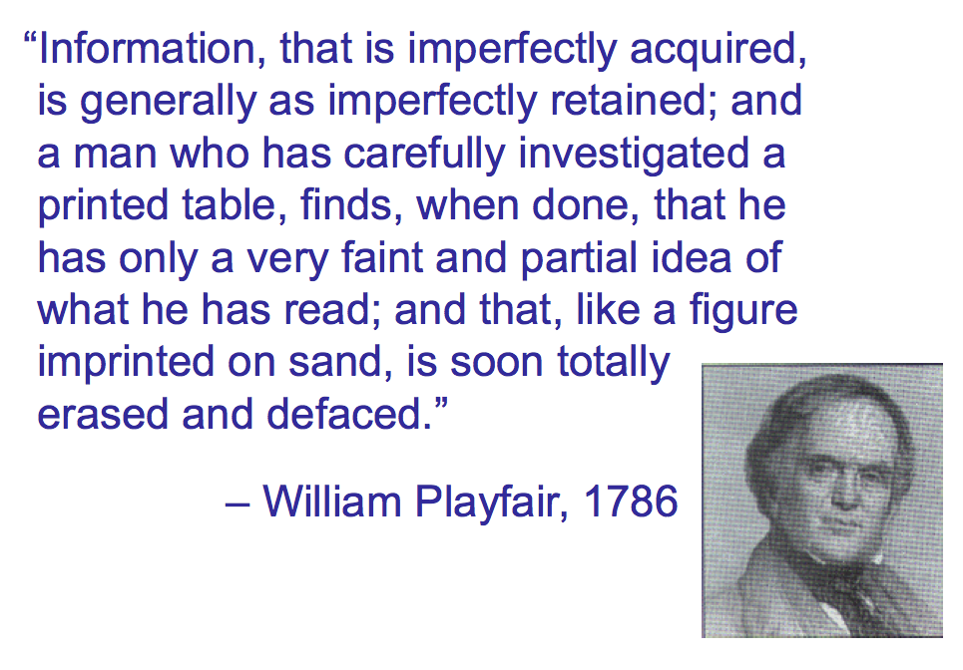
Notes:
ANSCOMBE’S Quartet

Slide 4
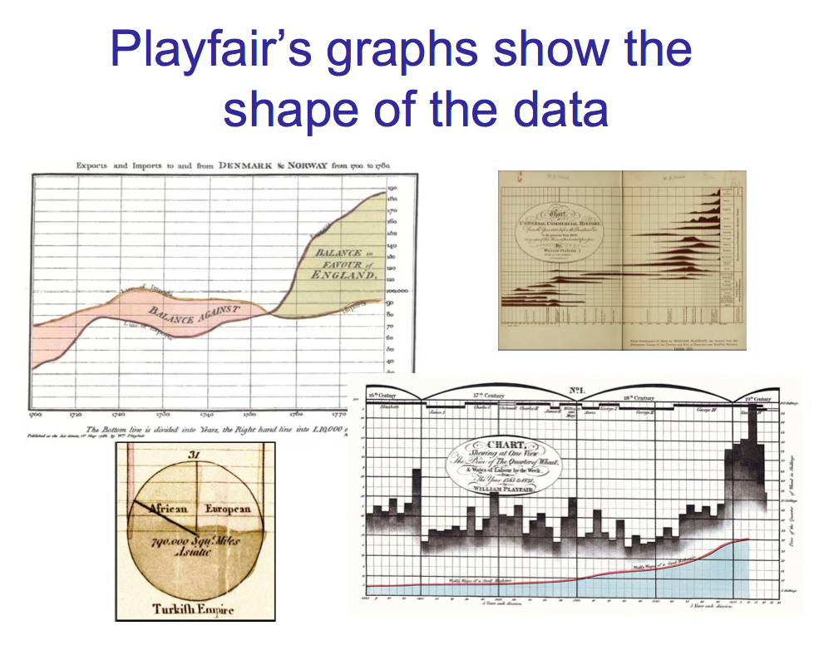
Notes:
ANSCOMBE’S Quartet

Slide 5
Anscombe’s Quartet
Notes:
ANSCOMBE’S Quartet

Slide 6
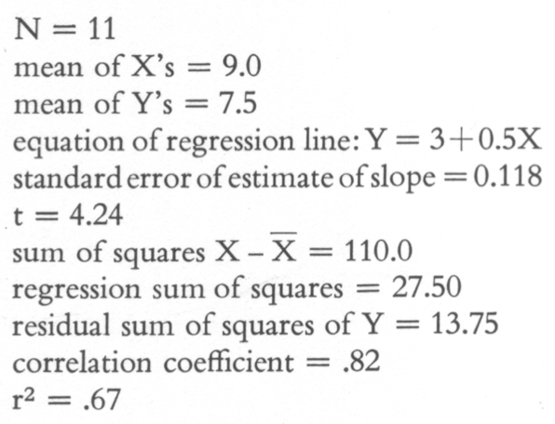
Statistical description of all four series
Notes:
ANSCOMBE’S Quartet

Slide 7
Graphical Representation of Statistical Fit
Notes:
ANSCOMBE’S Quartet

Slide 8
Graphical Representation of Actual Data
Group 1
Notes:
ANSCOMBE’S Quartet

Slide 9
Graphical Representation of Actual Data
Group 2
Notes:
ANSCOMBE’S Quartet

Slide 10
Graphical Representation of Actual Data
Group 3
Notes:
ANSCOMBE’S Quartet

Slide 11
Graphical Representation of Actual Data
Group 4
Notes:
ANSCOMBE’S Quartet

Slide 12
Anscombe’s Quartet
Notes:
ANSCOMBE’S Quartet

Slide 14
Visualization Matters
Very simple example
  Only 11 cases
  Data tables easily readable
However, there is a very low likelihood that a human would realize the big differences between the data sets (except Group 4).

Slide 15
Summary
Statistical methods are great tools.
They may mask true differences in data.
Visualization is crucial to the understanding of comparisons between data points and data series.

